Slide 1

FREELANCING AND EMPLOYING PLATFORM
UNDER THE SUPERVISION OF
PROF. TALAL SHIHABI & ENG.ESRAA QASEMY
Done By:
Tayma Abd Rabou
Hala Merie
Ghina Alqaseer
Sarah Akkasha

Slide 2

INTRODUCTION
our project is a platform that connects ..
services
courses
job opportunities
with who is looking for them
01

Slide 3





PROJECT PHASES
Planning
&
Analysis
Requirement
specification
Design
Coding
Testing
01 - 02
03
04
05 - 15
16 - 18
(IN WEEKS)
02

Slide 4
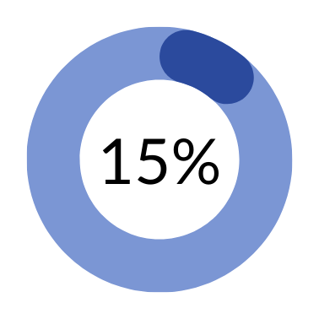

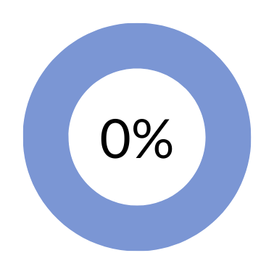
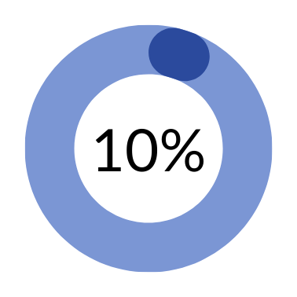
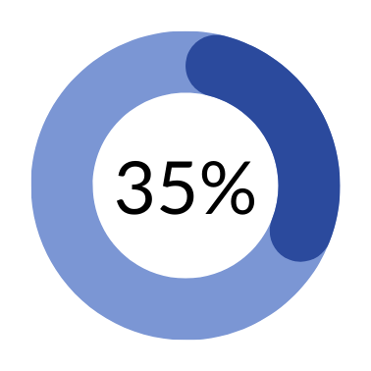
PROGRESS
Frontend
Backend
dashboard
report
presentation
03

Slide 5



PROGRAMMING LANGUAGES
04

Slide 6



TOOLS
05

Slide 7

RELATED WORKS
06

Slide 8
07
mobile/
website
Arabic /
English
offers
social
media
services
courses
jobs
linkedin
Both
Both
False
False
True
True
endeed
Both
Both
False
False
True
False
skillshare
Both
Arabic
False
True
False
False
khamsat
Website
Arabic
True
False
False
False
forsa
Website
Arabic
False
False
True
False
ours
mobile
Arabic
True
True
True
False

Slide 9

OBSTACLES
1
Learning new languages in short time
2
Contacting with e-payment company
08

Slide 10

THANK YOU
09

